Slide 1
Data-driven projects
A few thoughts

Slide 2



Slide 3
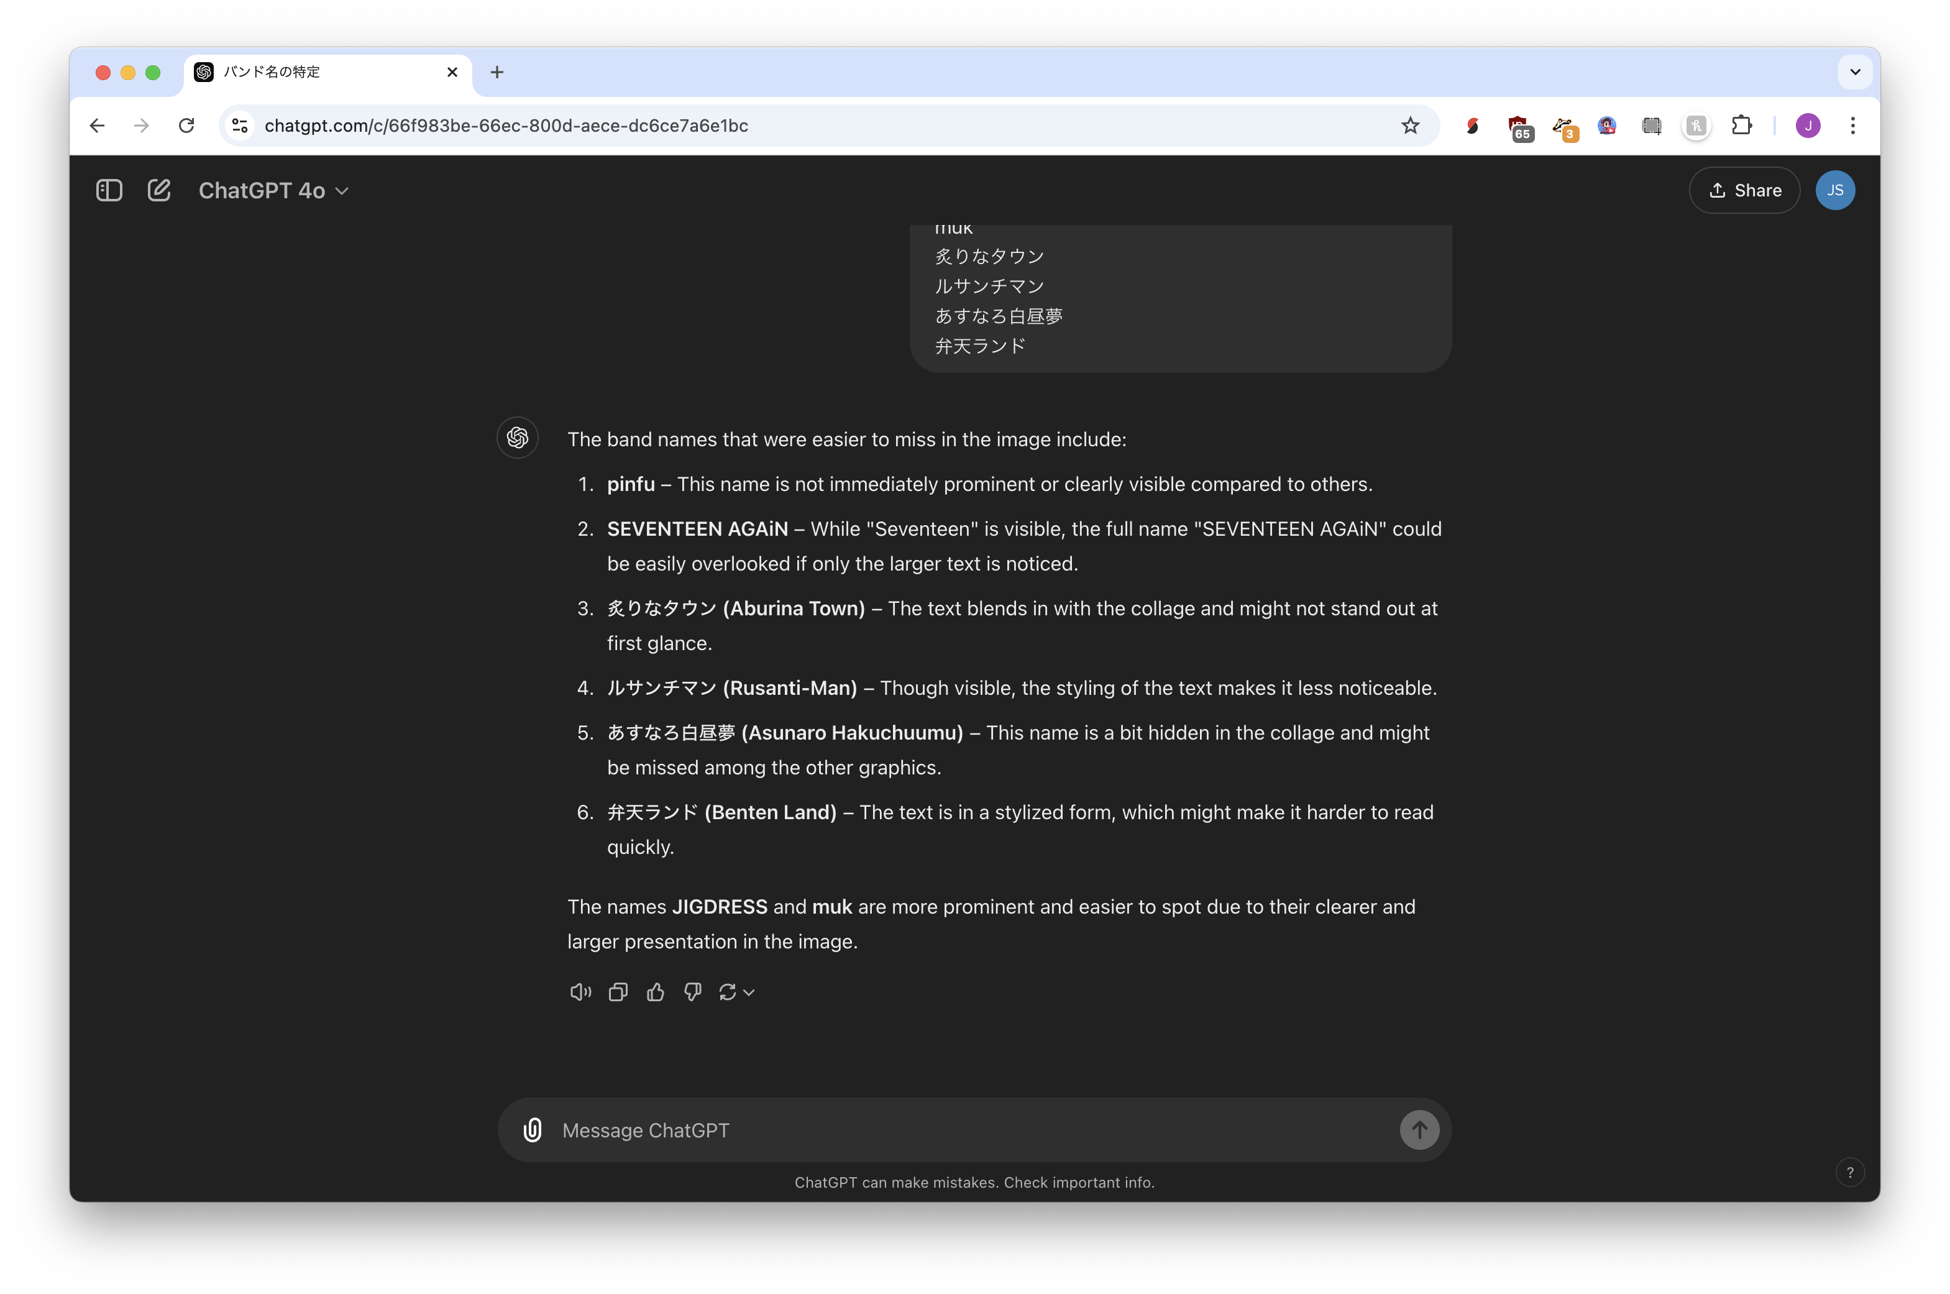
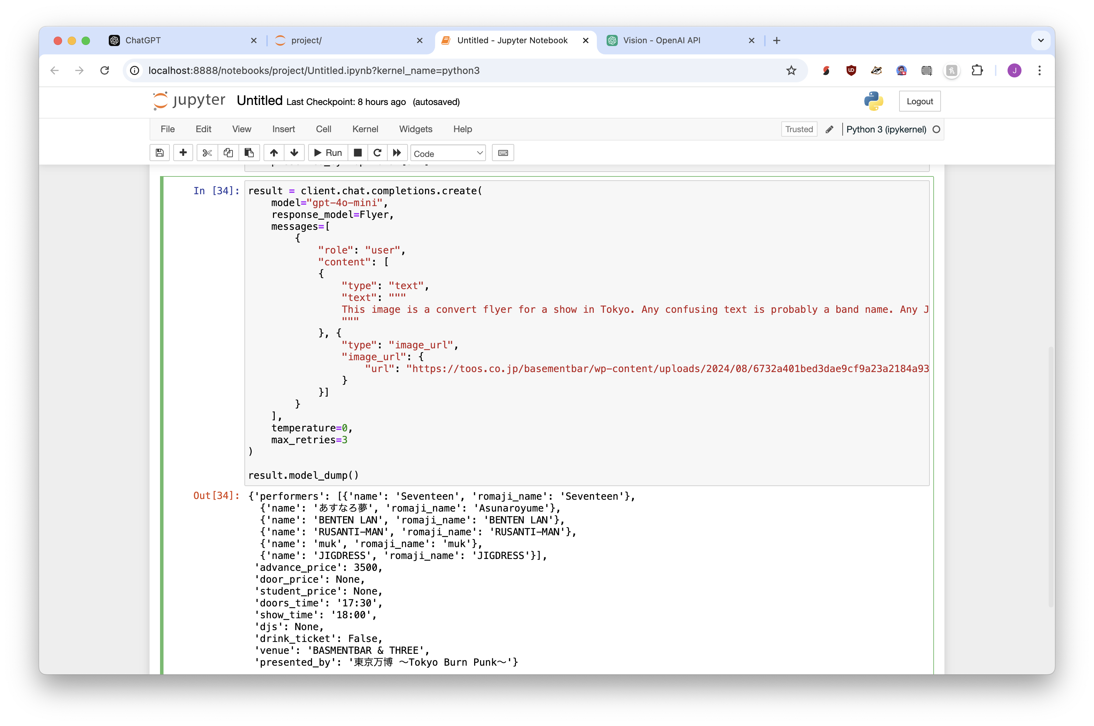

Slide 4
Projects
Managing data projects and coding projects is the worst thing
Estimates: all wrong
Data: all misunderstood
I hope you discovered that while you were working on this project!

Slide 5
Ideas
You have data. What can it be joined with?
Good target for automation: joining with data that frequently changes
“What columns would make this job more effective?”
Things that need to be done repeatedly
Things that are done by new hires
Sell something to others that benefits you, they’ll pay you to improve it

Slide 6







Tools are all additive
Relevant documents or websites
Text database of semantic embeddings
Transcribe something with Whisper
Semantic search
Speaker diarization with pyannote
Easier browsing
Suggested follow-ups
List of questions

Slide 7
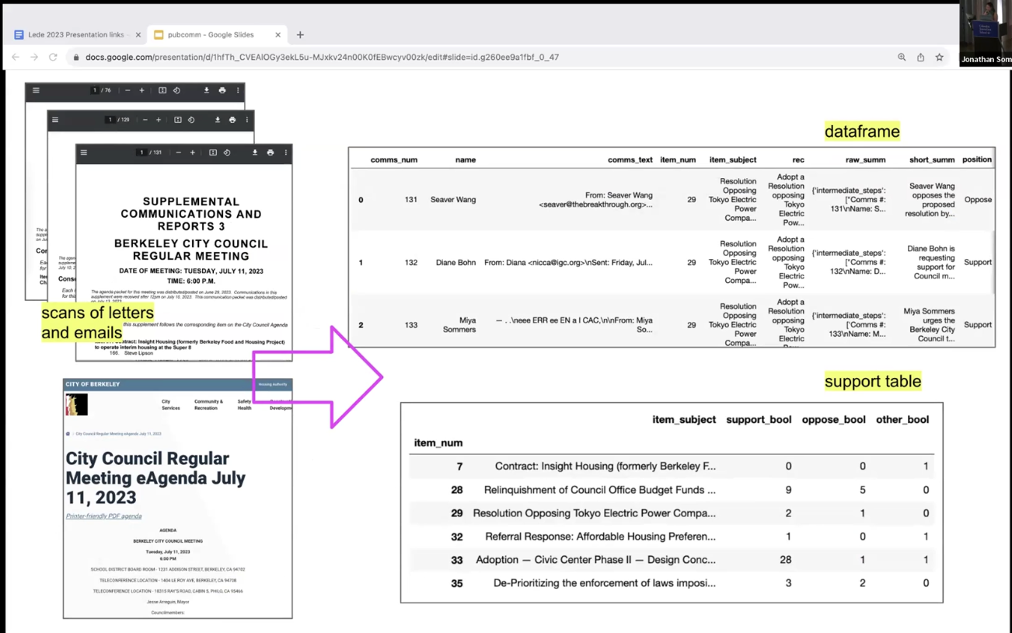




OCR of PDFs
Embed to cluster on topics??
LLM to summarize + determine position
Whisper to transcribe
Automate

Slide 8
Cost
Lots of venture capital = artificially cheap
Price is not related to ability
You will need ongoing support and adjustments
Don’t ignore this!!!!
Using a platform is better for big, quick changes
Journalism example: using an online Whisper tool vs. one built into in-house CMS infrastructure

Slide 9
Expertise
You (maybe) have the skills to prototype
Hire single-time-fee consultant for guidance
They have experience, most important early on
They know what is possible vs impossible
Best if not someone who can develop for you
Ask ”what do people use AI for that they should not?”
Don’t trust what any company says :)

Slide 10
Estimating
Estimating how long it takes is very hard
Estimating what you’ll need+want is very hard
You’ll get 80% of the way there in 20% of the time
Edge cases are the problem!
AI is good in “easy” cases but sometimes the hard cases are almost impossible
Never trust internal or external estimates.
Think days, weeks or month. Not a specific number.

Slide 11
Be open to change
Have a product that can be used at 80% ability
How can it be used with people instead of fully automated?
Data is often misunderstood, and you realize flaws later on. Can it still be used?
Beautiful visualization can hide bad analysis

Slide 12
Evaluations
Create number-based evaluations early on
Don’t just measure “accuracy”
What happens when it goes wrong?
If it’s human-in-the-loop, quality can be lower
Test with people who are suspicious of AI
Be sure to measure and test over time (weekly, monthly), models change

Slide 13
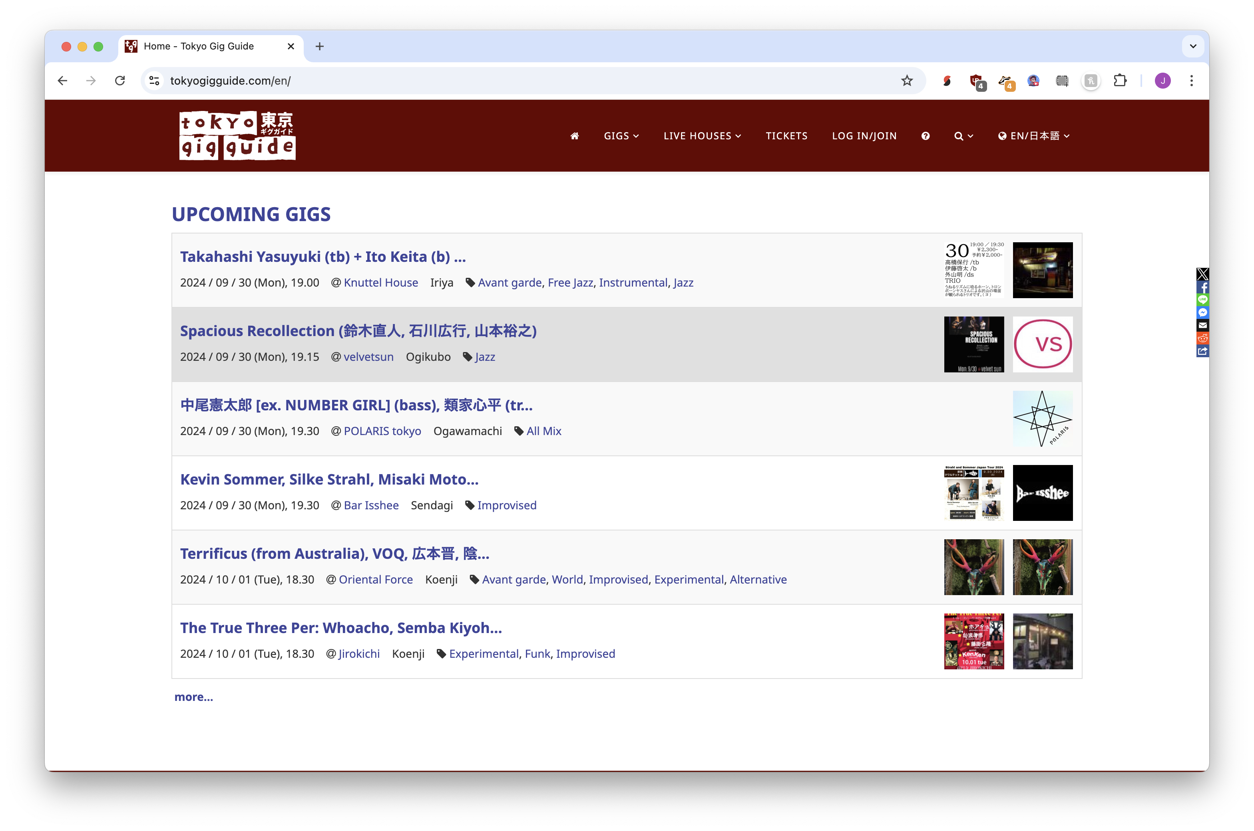

Slide 14
Data-driven projects
A few ideas

